Slide 1
2015-2016 iSpace FTC Kickoff Event Fundraising: Utilizing Local Resources
FTC 5029 PowerStackers
Notes:
Gloria

Slide 2
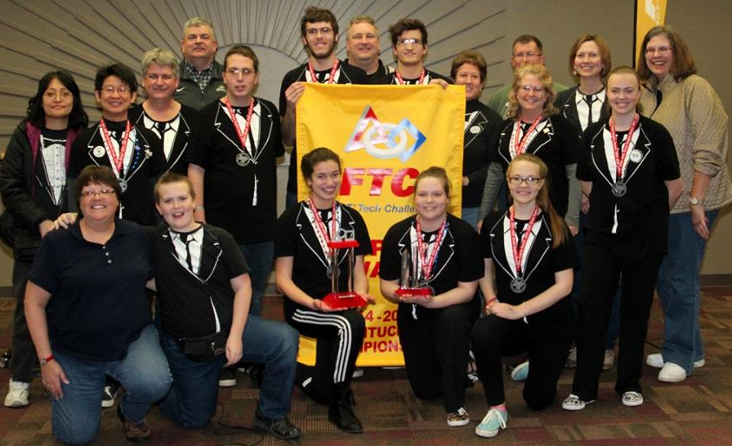
PowerStackers 5029
Meet Us
11 years
Coaches
Terence Chu
Caroline Buckey
Last Year
Inspire
San Antonio, Texas
Notes:
Cate

Slide 3
Why reach out?
Helps promote STEM and spread FIRST
Public speaking experience
Opportunity to learn various professions
Recruit new teammates
Connect Award
Helps spread your team
name in the community
Your community has a lot to offer
Notes:
gloria

Slide 4
Connect award
“The recipient of this award is recognized for helping the community understand FIRST, the FIRST Tech Challenge, and the team itself.”
-USFirst.org
Notes:
cate

Slide 5
Outreach
Communities and Sponsors can offer many opportunities for outreach, just a few of our outreaches,
City Council
Community Night Out
Technical companies
Dayton Children’s Hospital
Stores or Restaurants
High/Middle Schools / Libraries
Honor Seminar
Summer camps
Boy Scout and Cub Scout
Dayton Air Show
Museums : Family Day
Club Fairs / Outdoor festivals : Poultry Day
Sports events
FIRST events
FLL events held in your community
Notes:
gloria

Slide 6
Sponsors
Reaching out to potential sponsors in your area can make them more eager to help out
They won’t know about you if you don’t tell them you are there
Sponsors in your area can even lead to outreaches at the company
Sponsor Letters
Friends, Families, and Favorite Businesses
Follow up with companies

Slide 7
Recruiting Mentors
Variety
Come from
Local companies
Sponsors
Outreaches
Parents
Alumni of your teams
Other team connections

Slide 8
Fundraising
Each team member can lead each
Check all kinds of organizations in your area
Krispy Kreme
Restaurants
*Works better if there are lots of people attending
Yankee Candle
*Spring
*Fall

Slide 9
In Summary…
If you utilize your community you can get:
Sponsors
Fundraising
Outreach
Mentors
Awards
And even more…

Slide 10
Any Questions?
PowerStackers Contacts:
Website: www.powerstackersftc.com
Email: powerstackers@gmail.com
Facebook: PowerStackers 5029 First Tech Challenge Robotics Team
Twitter: @PowerStackers
Instagram: powerstackers5029
**This on website

