Slide 1
iSpace Kickoff 2016-2017 Outreach Workshop
FIRST Tech Challenge Team
5029 PowerStackers
Notes:
Gloria (both introduce)

Slide 2
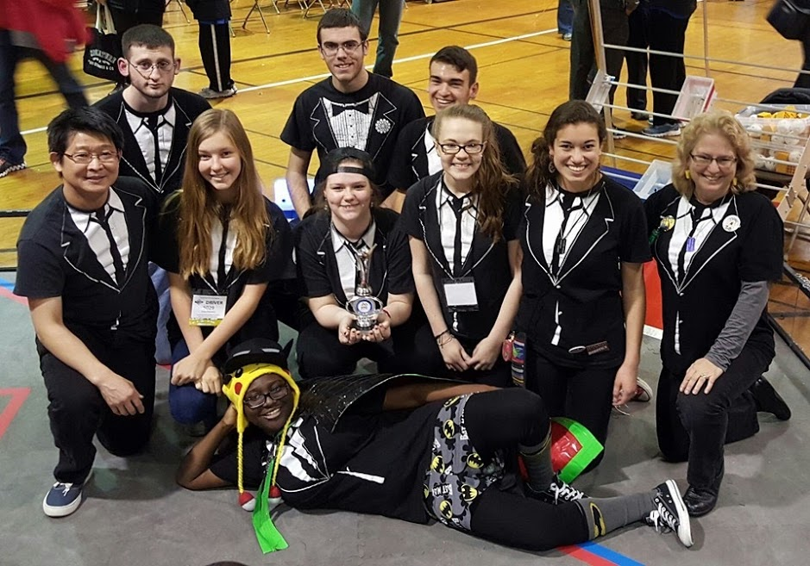
PowerStackers team 5029
Meet Us
12th year
Last year
Ohio State
Indiana State
Pennsylvania State
Notes:
Leena

Slide 3
Overview
Why Outreach?
Find Outreaches
How to Outreach
PowerStackers Tips
Summary
Questions?
Contact Info
Notes:
Gloria

Slide 4
Why Outreach?
Share your prior knowledge
Grow your skill set and knowledge
Help your team grow
Help your community
Help the FIRST and STEM communities
Build partnerships
Looks good
Win Awards
Notes:
Leena

Slide 5
Knowledge
You can share knowledge through outreaches
Spread FIRST
Increase interest levels
Teach about your robots
You can gain knowledge through outreaches
Learn about companies and professions
Learn about public speaking
Increase your comfort level
Notes:
Leena

Slide 6
Community Connections
Help your team grow
New members, new mentors, new sponsors
Help your community
Tell them about FIRST
Find a team for them to join
Help FIRST and STEM communities
Spread FIRST, make it loud
Get more students involved
Partnerships
Recurring outreaches
Sponsors
Notes:
Leena

Slide 7
How it Looks
Count your outreaches
Count the number of people you’ve reached out to
Notes:
Gloria

Slide 8
How it Looks
Notes:
Gloria

Slide 9
Connect Award
This award goes to the team who…
Connects community, FIRST, and the business world
Connects with their local STEM community
Helps the community understand FIRST, the FIRST Tech Challenge, and the team
Seeks engineers and explores opportunities available in STEM fields
Has a clear Business/Strategic Plan and has identified steps to achieve their goals
Notes:
Leena

Slide 10
Find Outreaches
Use your community
Examples:
City Council
Technical Companies and Sponsors
Hospitals
Stores and Restaurants
Schools and Libraries
Summer Camps
Other FIRST Events (competitions, mentoring)
Boy Scouts
Museums
Fairs and Festivals
Sports Events
Competitions
Interested Students
Fundraisers
Notes:
Gloria

Slide 11
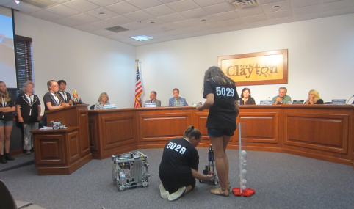
Find Outreaches
Examples:
City Council
Technical Companies and Sponsors
Hospitals
Stores and Restaurants
Schools and Libraries
Summer Camps
Other FIRST Events (competitions, mentoring)
Boy Scouts
Museums
Fairs and Festivals
Sports Events
Competitions
Interested Students
Fundraisers
Notes:
Gloria

Slide 12
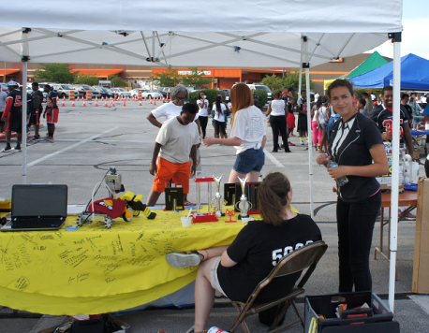
Find Outreaches
Examples:
City Council
Technical Companies and Sponsors
Hospitals
Stores and Restaurants
Schools and Libraries
Summer Camps
Other FIRST Events (competitions, mentoring)
Boy Scouts
Museums
Fairs and Festivals
Sports Events
Competitions
Interested Students
Fundraisers
Notes:
Leena

Slide 13
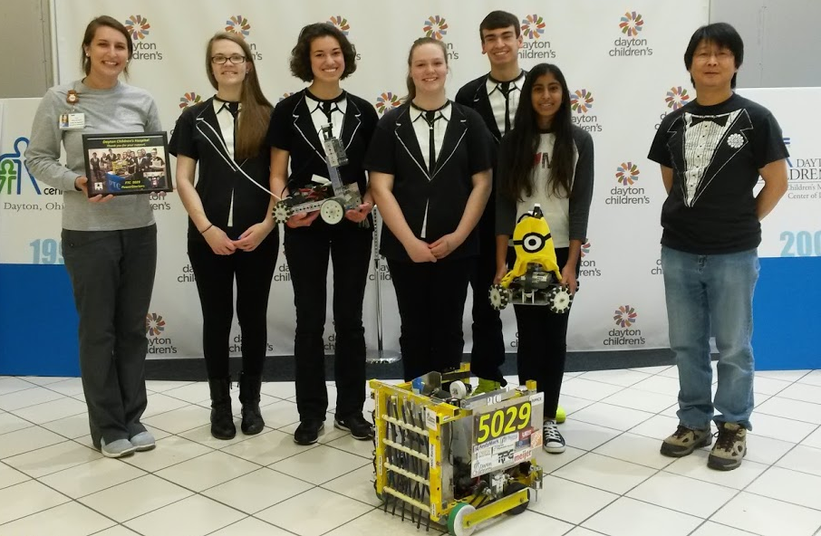
Find Outreaches
Examples:
City Council
Technical Companies and Sponsors
Hospitals
Stores and Restaurants
Schools and Libraries
Summer Camps
Other FIRST Events (competitions, mentoring)
Boy Scouts
Museums
Fairs and Festivals
Sports Events
Competitions
Interested Students
Fundraisers
Notes:
Gloria

Slide 14
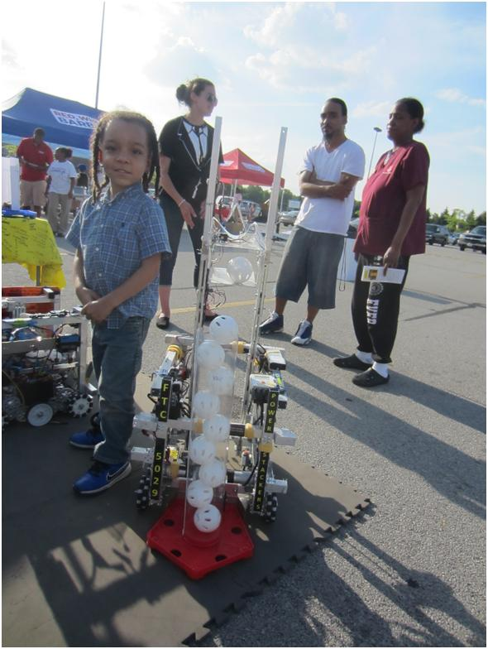
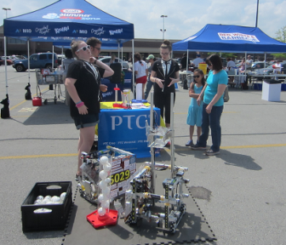
Find Outreaches
Examples:
City Council
Technical Companies and Sponsors
Hospitals
Stores and Restaurants
Schools and Libraries
Summer Camps
Other FIRST Events (competitions, mentoring)
Boy Scouts
Museums
Fairs and Festivals
Sports Events
Competitions
Interested Students
Fundraisers
Notes:
Leena

Slide 15
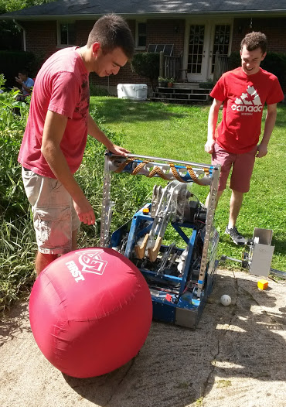
Find Outreaches
Examples:
City Council
Technical Companies and Sponsors
Hospitals
Stores and Restaurants
Schools and Libraries
Summer Camps
Other FIRST Events (competitions, mentoring)
Boy Scouts
Museums
Fairs and Festivals
Sports Events
Competitions
Interested Students
Fundraisers
Notes:
Gloria

Slide 16
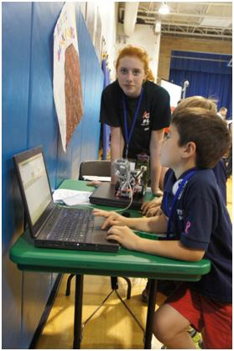
Find Outreaches
Examples:
City Council
Technical Companies and Sponsors
Hospitals
Stores and Restaurants
Schools and Libraries
Summer Camps
Other FIRST Events (competitions, mentoring)
Boy Scouts
Museums
Fairs and Festivals
Sports Events
Competitions
Interested Students
Fundraisers
Notes:
Leena

Slide 17
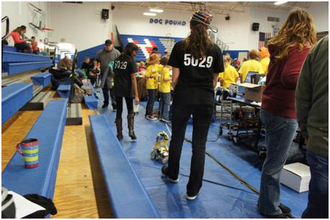
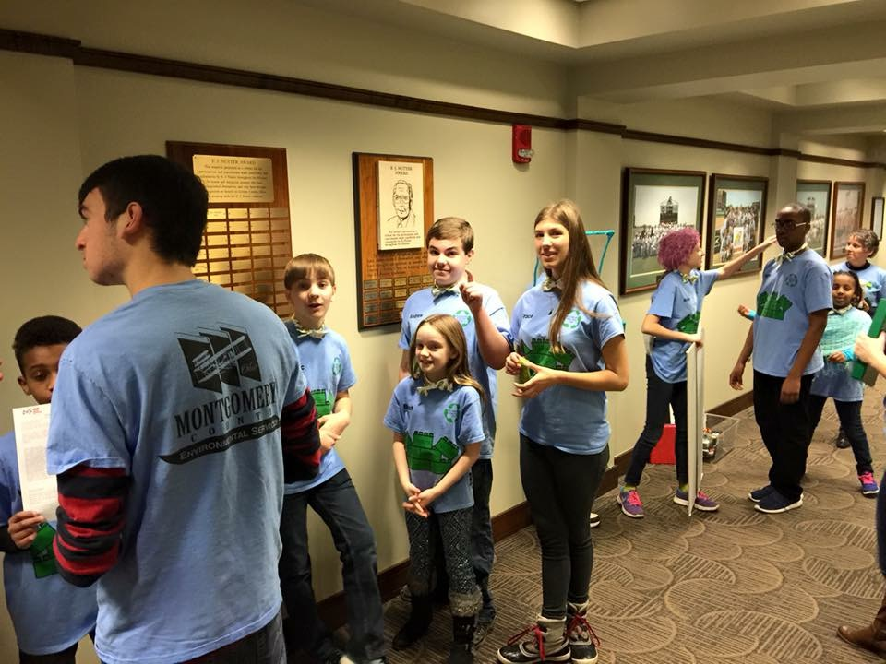
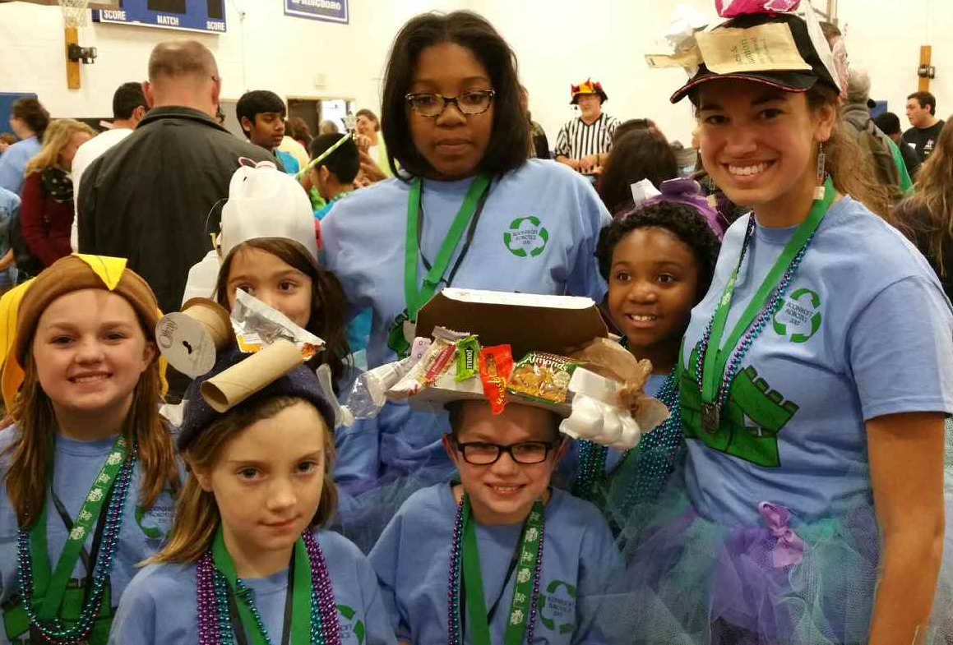
Find Outreaches
Examples:
City Council
Technical Companies and Sponsors
Hospitals
Stores and Restaurants
Schools and Libraries
Summer Camps
Other FIRST Events (competitions, mentoring)
Boy Scouts
Museums
Fairs and Festivals
Sports Events
Competitions
Interested Students
Fundraisers
Notes:
Gloria

Slide 18
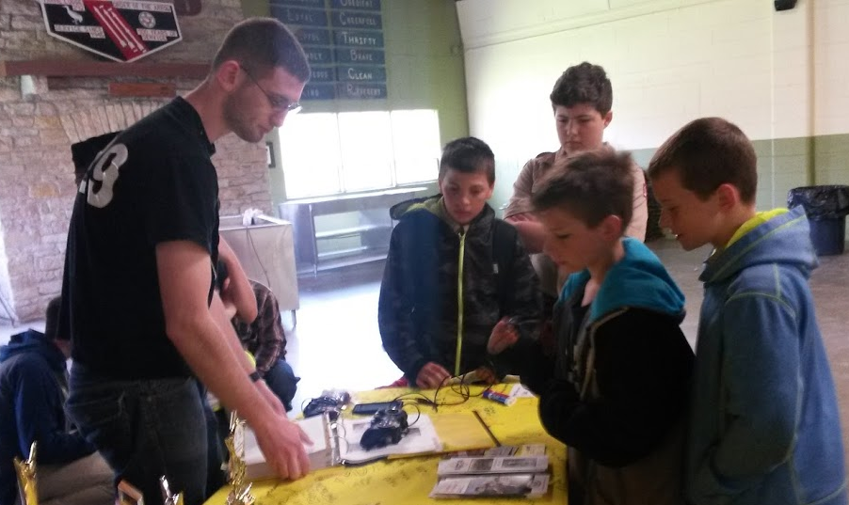
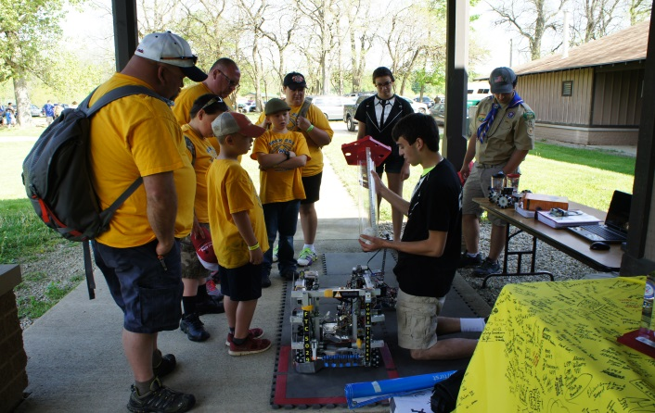
Find Outreaches
Examples:
City Council
Technical Companies and Sponsors
Hospitals
Stores and Restaurants
Schools and Libraries
Summer Camps
Other FIRST Events (competitions, mentoring)
Boy Scouts
Museums
Fairs and Festivals
Sports Events
Competitions
Interested Students
Fundraisers
Notes:
Leena

Slide 19
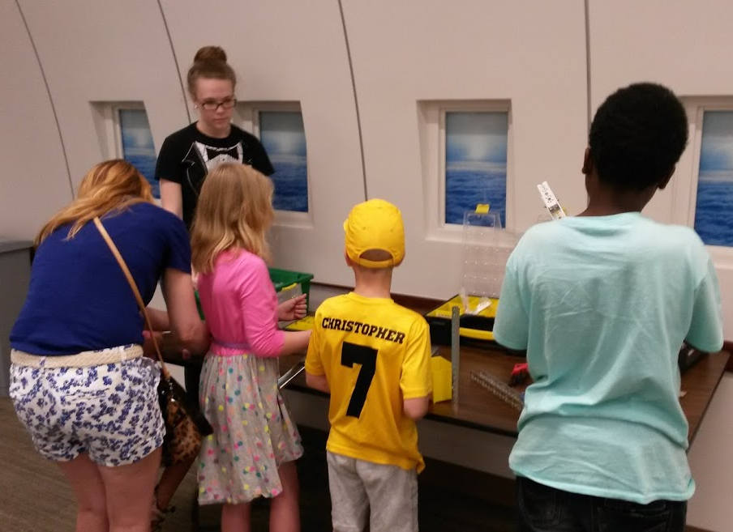
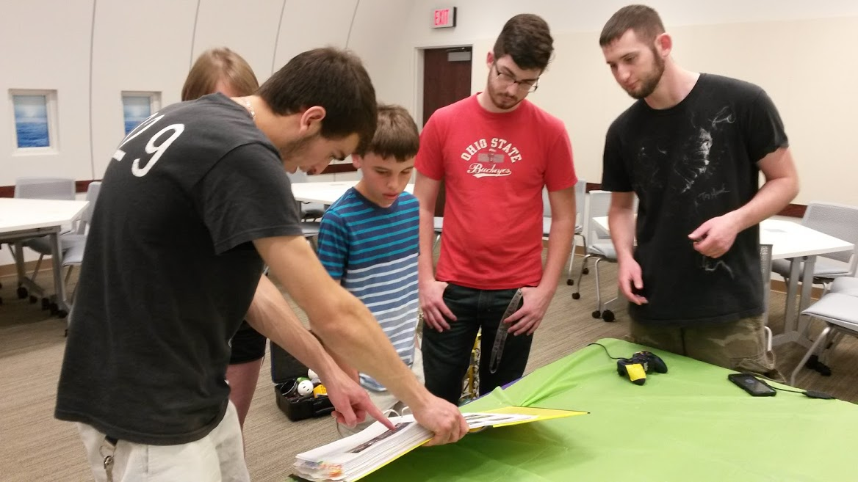
Find Outreaches
Examples:
City Council
Technical Companies and Sponsors
Hospitals
Stores and Restaurants
Schools and Libraries
Summer Camps
Other FIRST Events (competitions, mentoring)
Boy Scouts
Museums
Fairs and Festivals
Sports Events
Competitions
Interested Students
Fundraisers
Notes:
Gloria

Slide 20
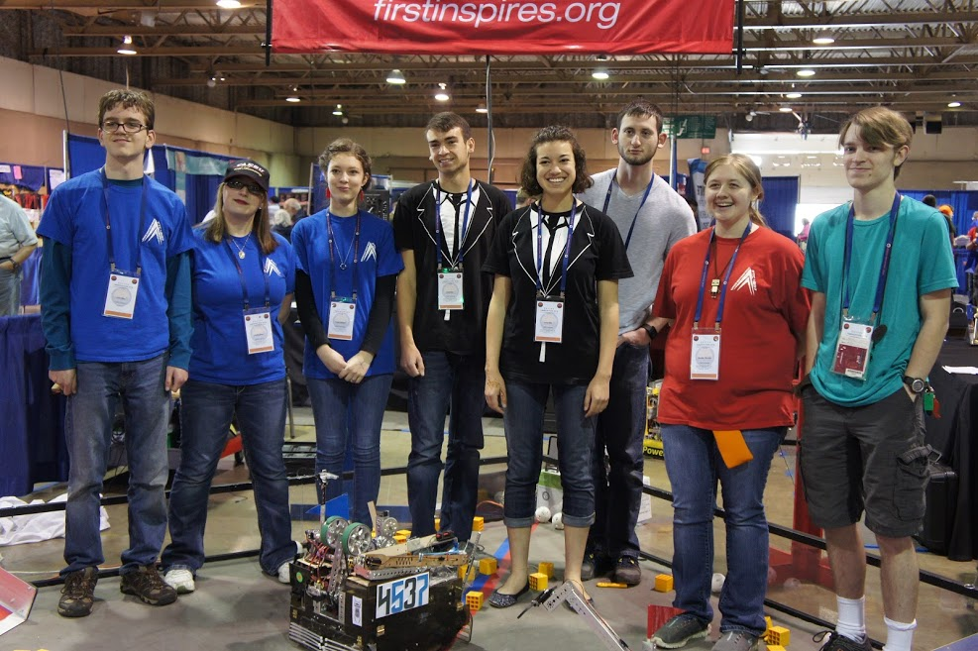
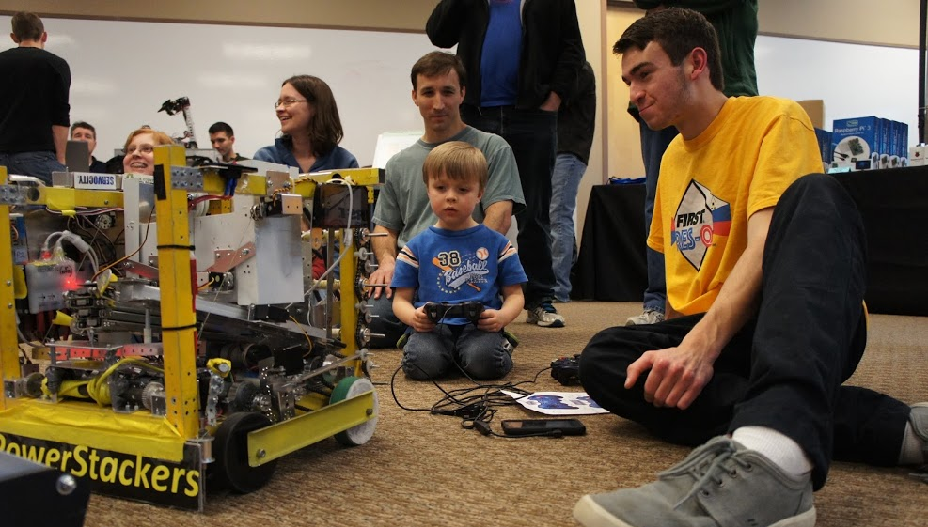
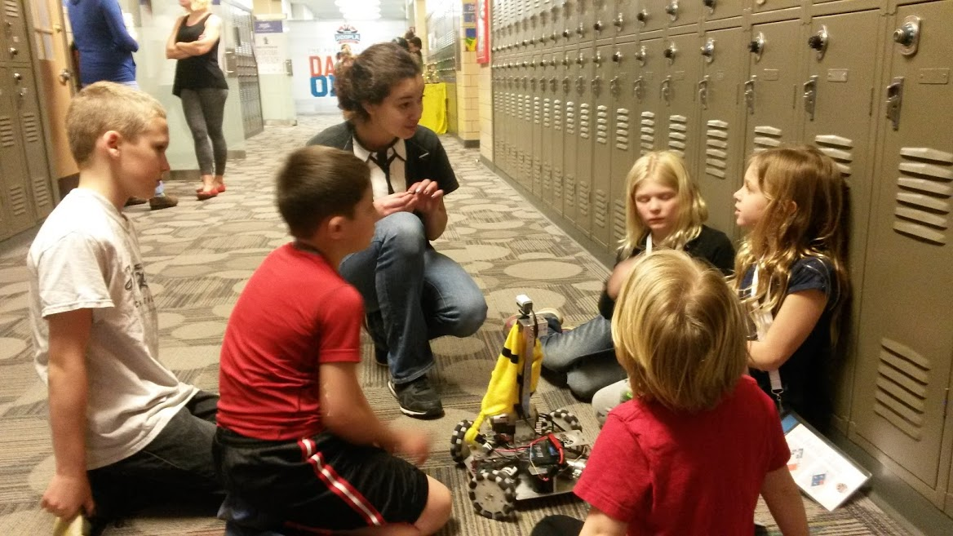
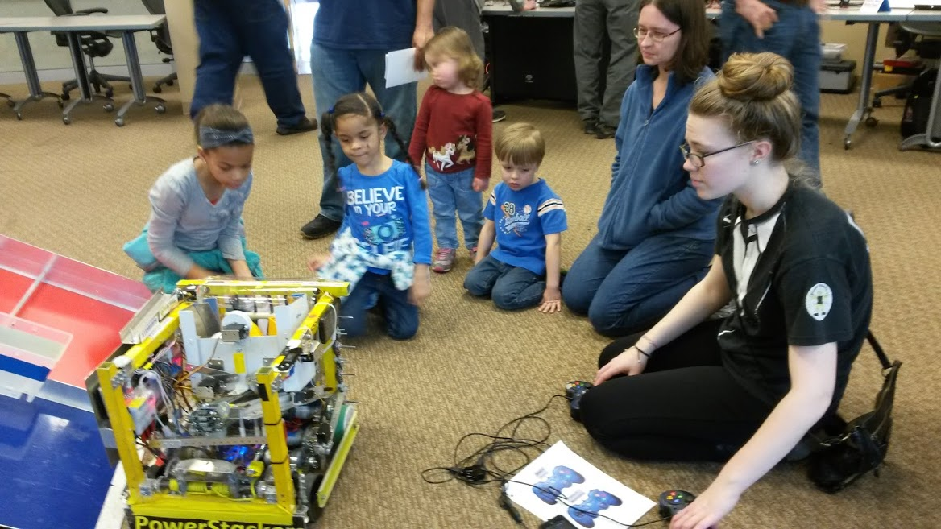
Find Outreaches
Examples:
City Council
Technical Companies and Sponsors
Hospitals
Stores and Restaurants
Schools and Libraries
Summer Camps
Other FIRST Events (competitions, mentoring)
Boy Scouts
Museums
Fairs and Festivals
Sports Events
Competitions
Interested Students
Fundraisers
Notes:
Leena

Slide 21
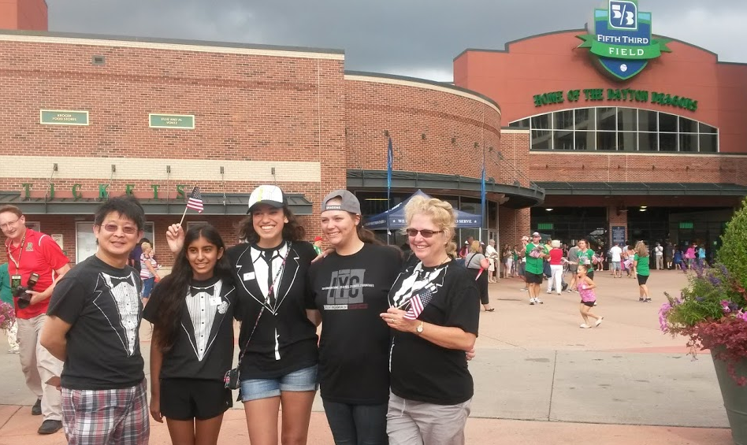
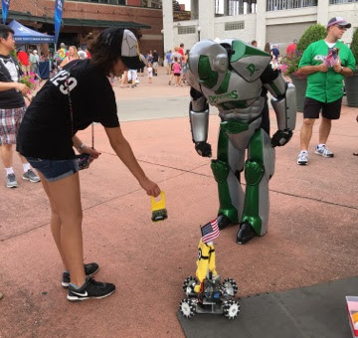
Find Outreaches
Examples:
City Council
Technical Companies and Sponsors
Hospitals
Stores and Restaurants
Schools and Libraries
Summer Camps
Other FIRST Events (competitions, mentoring)
Boy Scouts
Museums
Fairs and Festivals
Sports Events
Competitions
Interested Students
Fundraisers
Notes:
Gloria

Slide 22
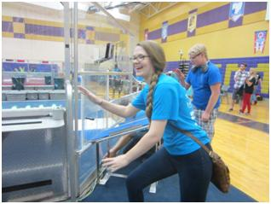
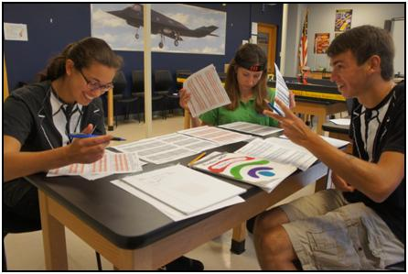
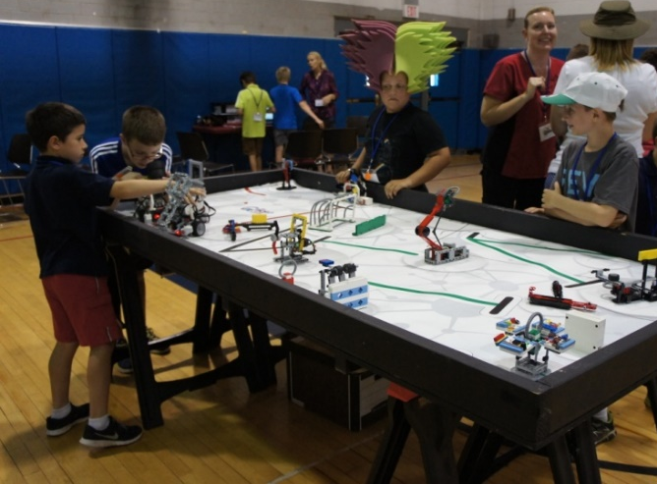
Find Outreaches
Examples:
City Council
Technical Companies and Sponsors
Hospitals
Stores and Restaurants
Schools and Libraries
Summer Camps
Other FIRST Events (competitions, mentoring)
Boy Scouts
Museums
Fairs and Festivals
Sports Events
Competitions
Interested Students
Fundraisers
Notes:
Leena (talk about how few people outreaches count (like at hotels the night before a competition))

Slide 23
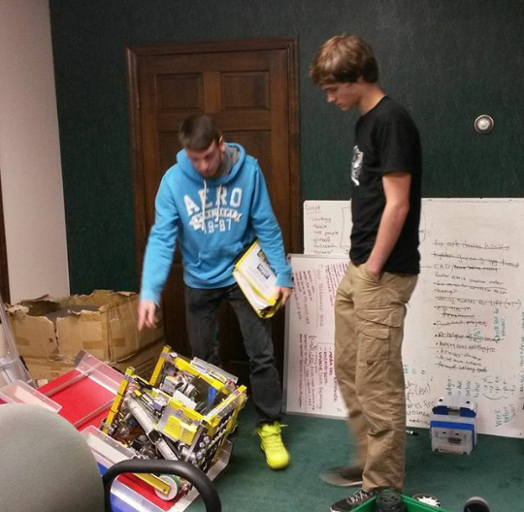
Find Outreaches
Examples:
City Council
Technical Companies and Sponsors
Hospitals
Stores and Restaurants
Schools and Libraries
Summer Camps
Other FIRST Events (competitions, mentoring)
Boy Scouts
Museums
Fairs and Festivals
Sports Events
Competitions
Interested Students
Fundraisers
Notes:
Gloria

Slide 24
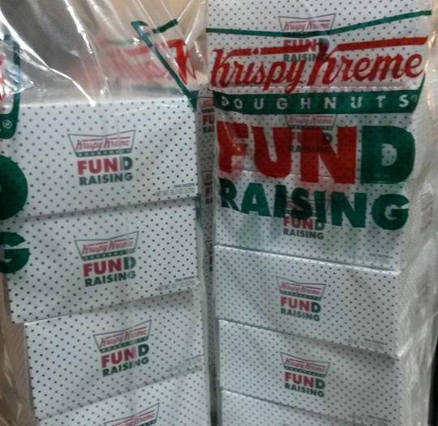
Find Outreaches
Examples:
City Council
Technical Companies and Sponsors
Hospitals
Stores and Restaurants
Schools and Libraries
Summer Camps
Other FIRST Events (competitions, mentoring)
Boy Scouts
Museums
Fairs and Festivals
Sports Events
Competitions
Interested Students
Fundraisers
Notes:
Leena

Slide 25
How to Outreach
Train new members:
Introduce yourself
Talk about FIRST
Ask their age, or their kid’s age
Explain the other three levels (Jr. FLL, FLL, FRC)
Go into FTC
Explain your team
Show the robot (explain what it does)
Show the engineering notebook
Answer any questions
Ask one of your teammates if you don’t know the answer
Notes:
Gloria

Slide 26
PowerStackers Tips
Use your community
Be comfortable
Don’t be afraid to say you are nervous
Be prepared
Think outside the box
Keep a log of outreaches throughout your season
Count everything as an outreach
Just talk about FIRST all the time (nerd)
Notes:
Leena

Slide 27
Summary
Why Outreach?
Grow knowledge & community
Gain connections
How it Looks
Find Outreaches
Basically any & everywhere
How to Outreach
FIRST & 4 levels
Your team
Questions
PowerStackers Tips
Use your community
Be comfortable & prepared
Think outside the box
Keep track of the numbers
Notes:
Gloria

Slide 28
Questions? Contact Info:
Website: powerstackersftc.weebly.com
Email: powerstackers@gmail.com
Twitter: @PowerStackers
Facebook: PowerStackers 5029 FIRST Tech Challenge Robotics Team
Instagram: powerstackers 5029
**On website?
Notes:
Leena (both answer any questions)

