Slide 1


2015-2016 iSpace Kickoff
Intro to PTC CAD
PowerStackers
Team 5029
Notes:
Gloria

Slide 2
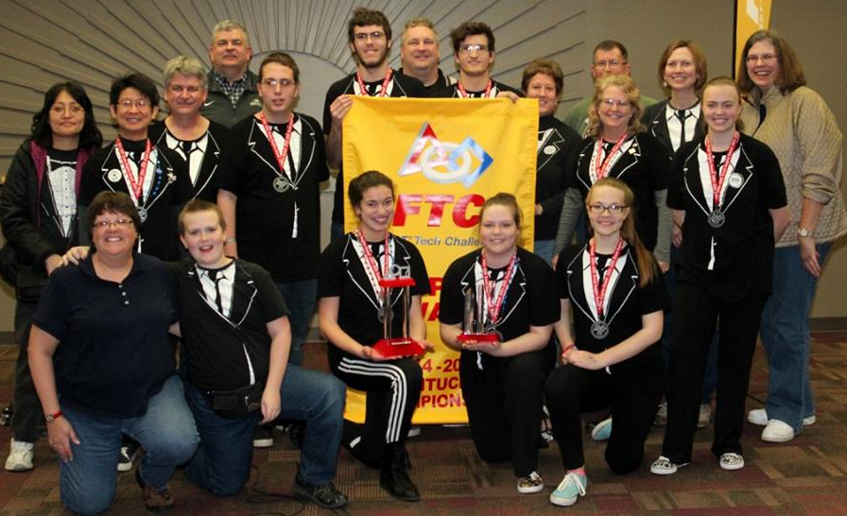
PowerStackers
5029
Meet Us
11 years
Coaches
  Terence Chu
  Caroline Buckey
Last Year
  Inspire
  San Antonio, Texas

Slide 3
Introduction
What is CAD? Why use CAD?
Different CAD programs
Real World Applications
Dimensions
Basic Operations
Measuring
3D Printing
Examples
Awards
Questions and Contacts

Slide 4
What is CAD?
Why use CAD?
Computer Aided Design
Using computer software to model parts or assemblies before making them for a number of reasons, some being:
  Save time
  Save materials
  Good skill to have
  Visualizing before building
Notes:
Caroline

Slide 5
Different CAD Programs
There are many different types of CAD:
  AutoCAD
  Inventor
  PTC
  Sketchup
  SolidWorks
PTC sponsors FIRST, but is not required
  Free licenses

Slide 6
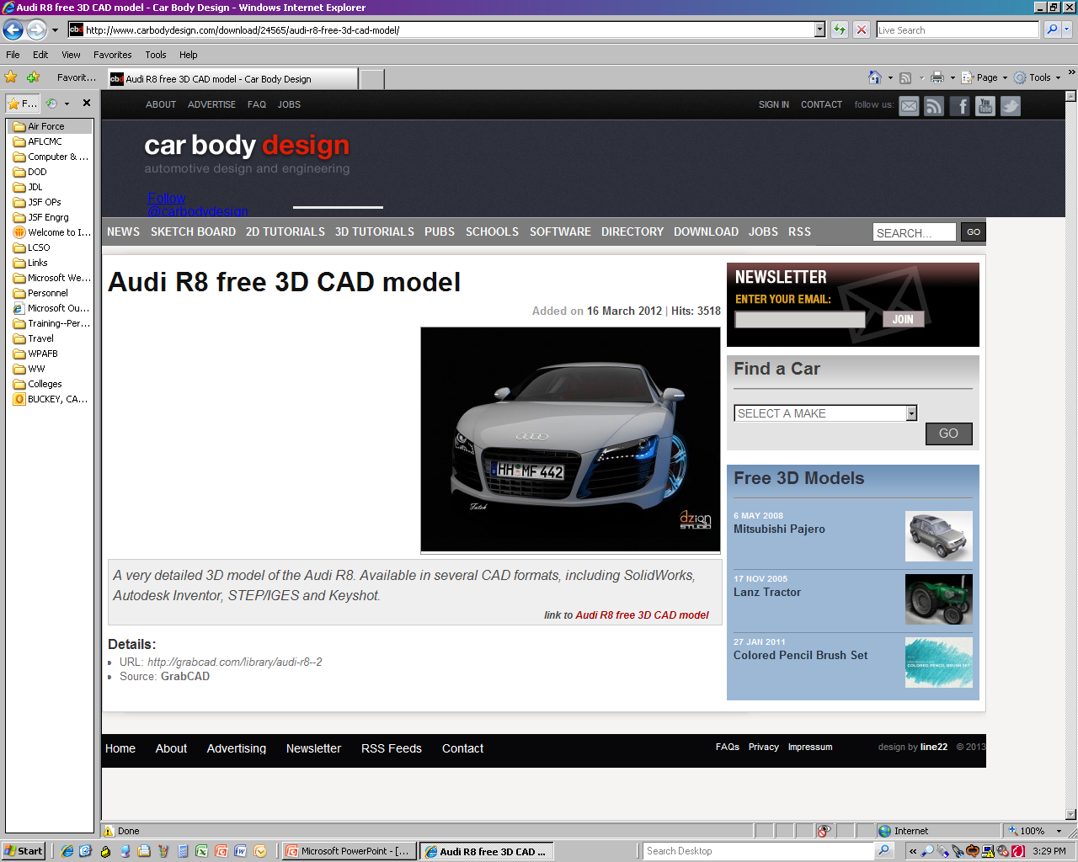
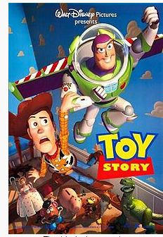
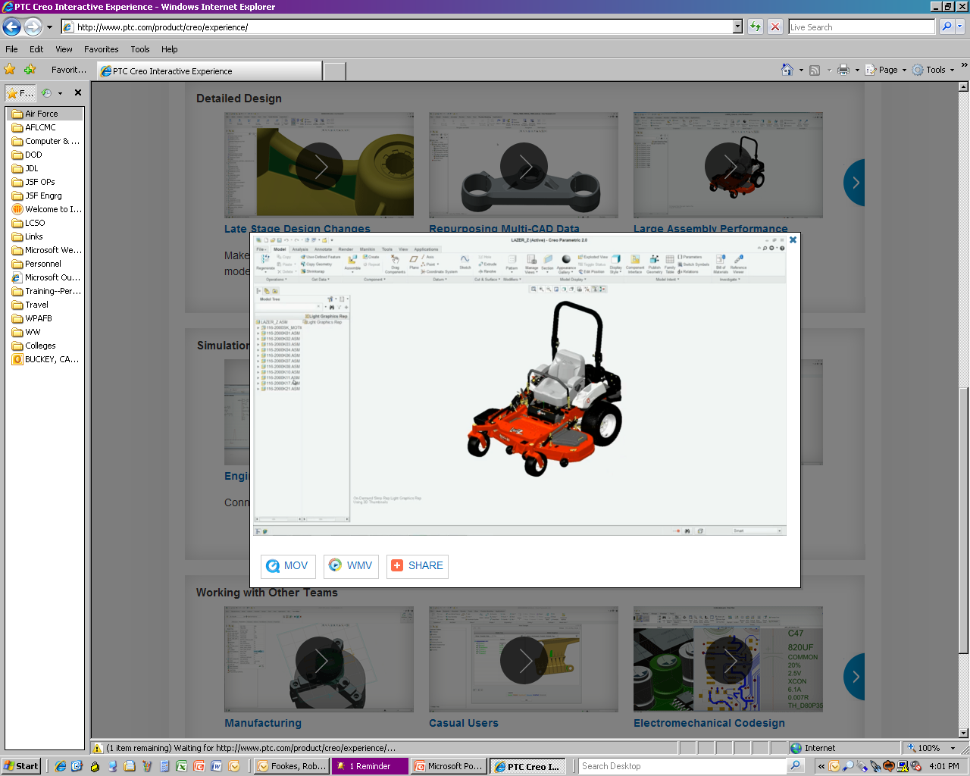
Real World Applications
Computer Aided Design
  --Industrial Art
  --CAD/CAM/CAE
--Used by architects, engineers, artists, etc.
Applications
  --Cars, Ships, and Planes
  --Prosthetics
  --Movies and TV shows
Notes:
Gloria

Slide 7
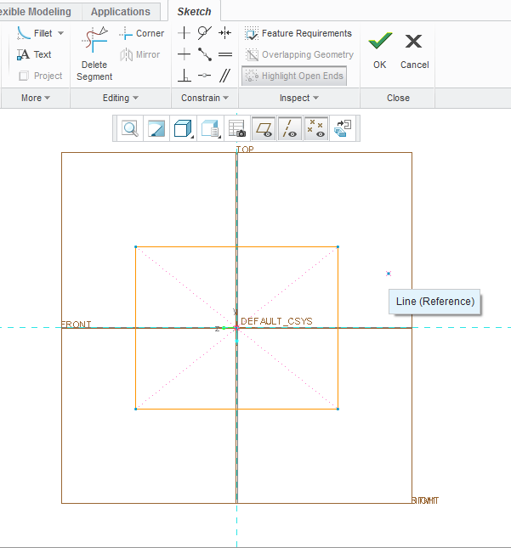
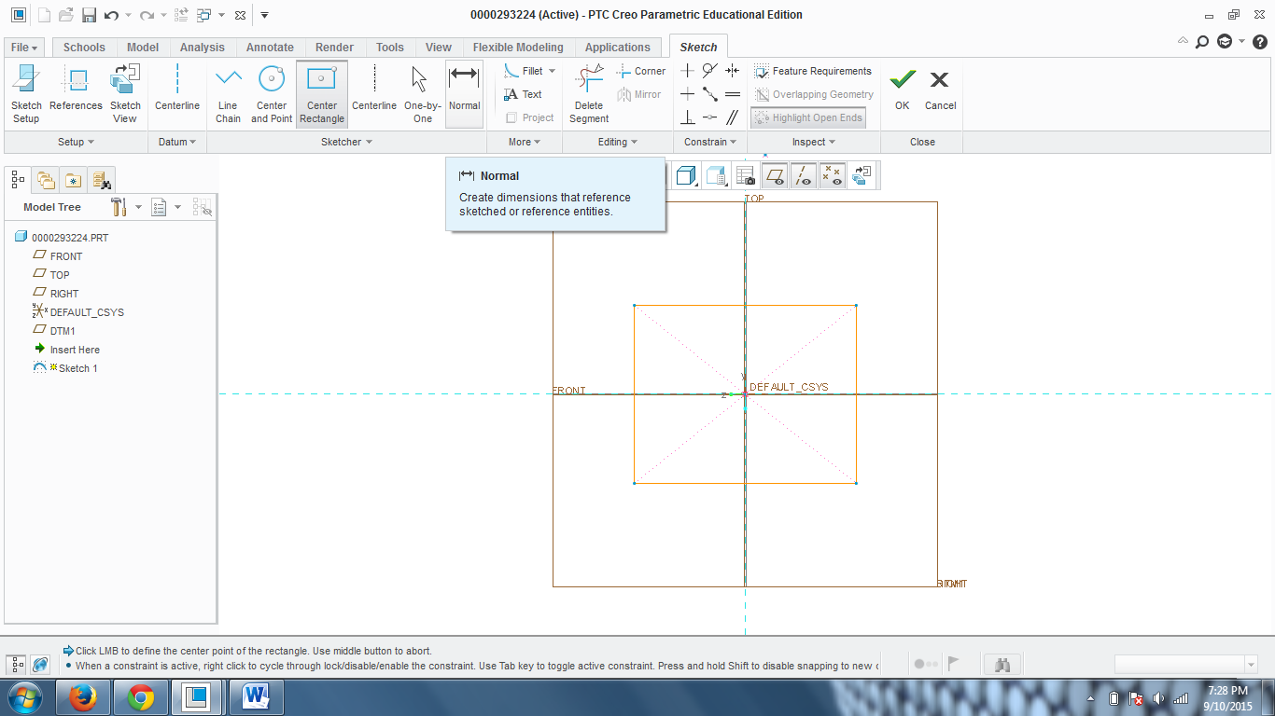
Taking Dimensions
Colleen was here
Create Part
Hover over “Normal”
Notes:
Caroline

Slide 8
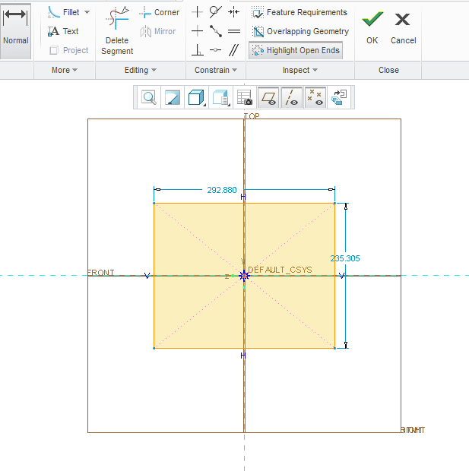
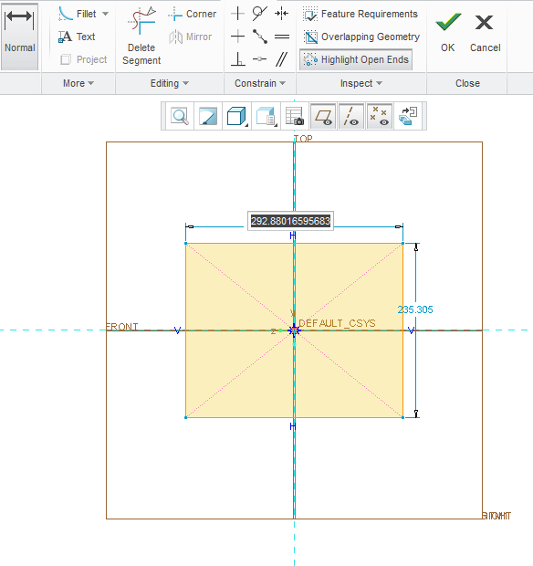
Taking Dimensions
Colleen was here
Press “Normal”
(escape also works)
Double click on the Dimension
Type in the dimension

Slide 9
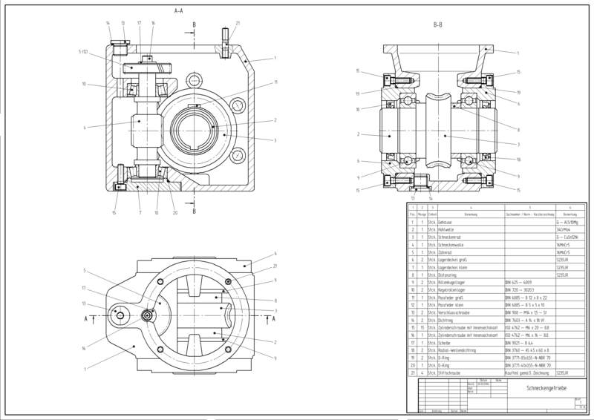
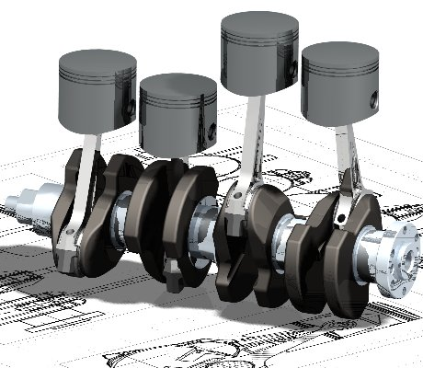
2D and 3D
2D Sketch
  Easily view measurements
  Custom make parts
3D Part
  Test maneuverability
  See how pieces fit
  together

Slide 10
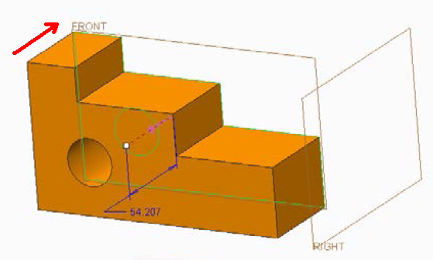
Basic Operations
Extending a 2D sketch into 3D shape.
  Extrude – extending a x-section in a straight line into 3D
  Revolve – revolving a x-section about an axis
  Sweep – sweeping a x-section along a curve
  Blend – blending 2 or more x-sections between them along a curve
Notes:
Gloria

Slide 11
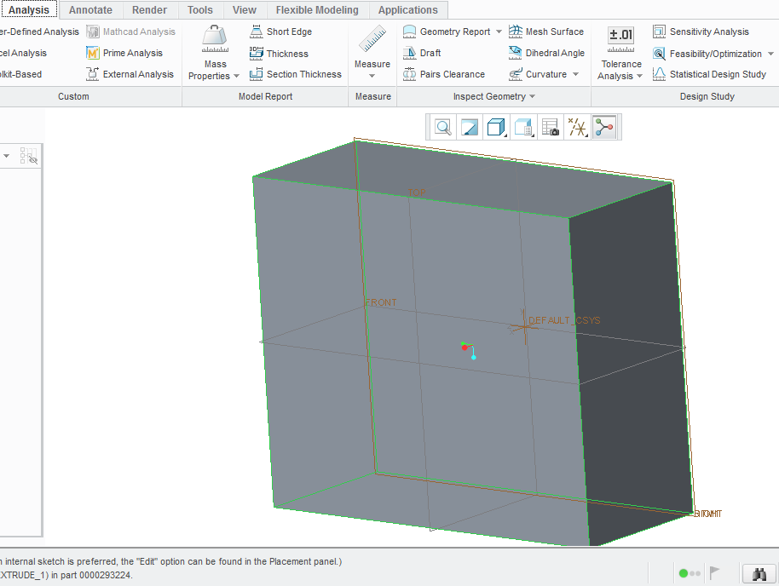
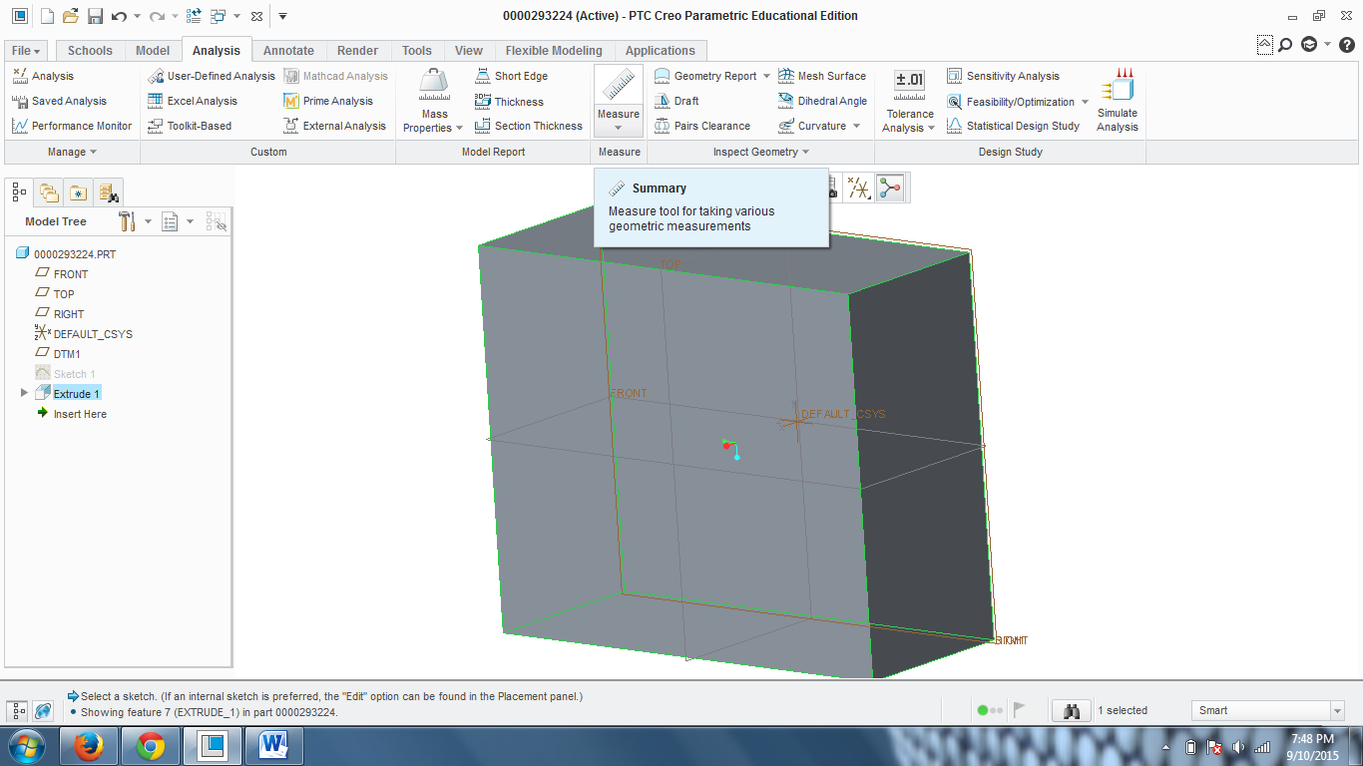
Measuring
Colleen was here too
Go to “Analysis” Tab
Hover over the “Measure” Button
Notes:
Caroline

Slide 12
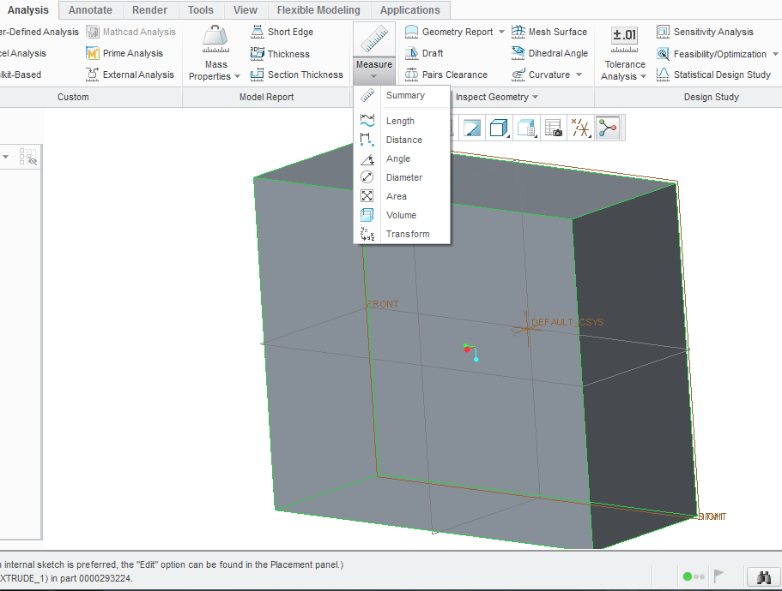
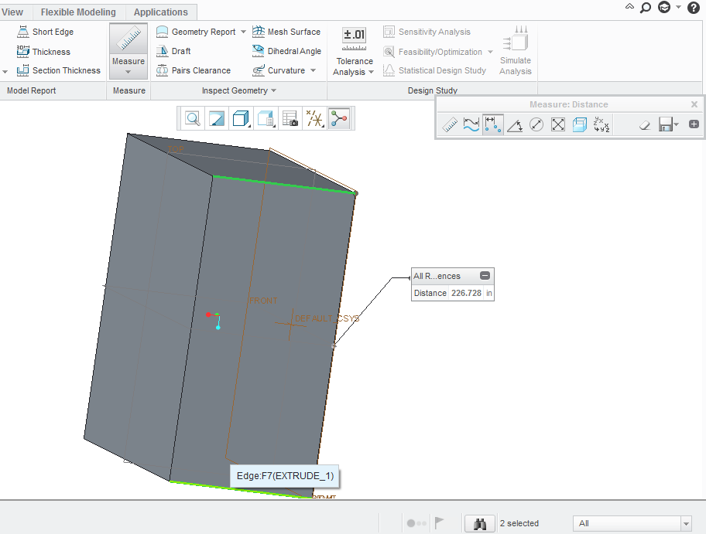
Measuring
Colleen was here too
Click on “Measure”
Button
Use ctrl and click on two edges to get distance

Slide 13
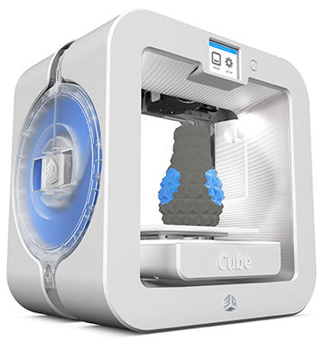
3D Printing
You can take your CAD documents and turn them into 3D objects
  -- Print your own parts
  -- Have your sponsors
  print parts for you
  -- Contact 3D printing
  companies
Notes:
Gloria

Slide 14
Some 2014-2015
Examples from the
Cascade Effect Season
Notes:
Gloria

Slide 15
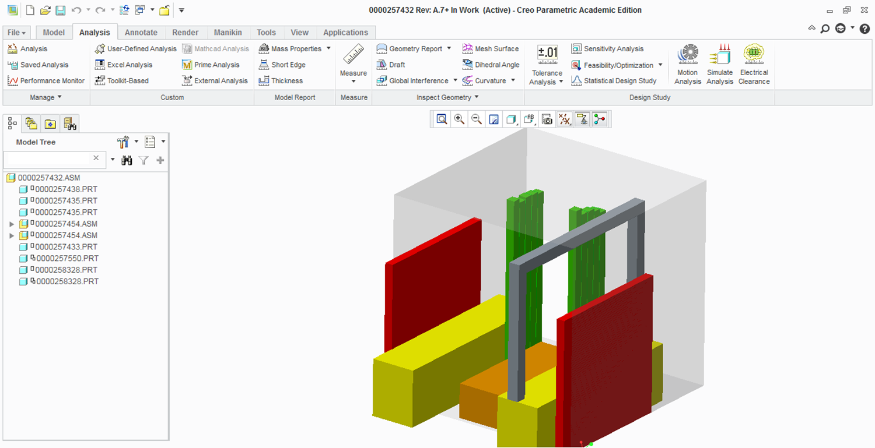
Conceptual Process

Slide 16
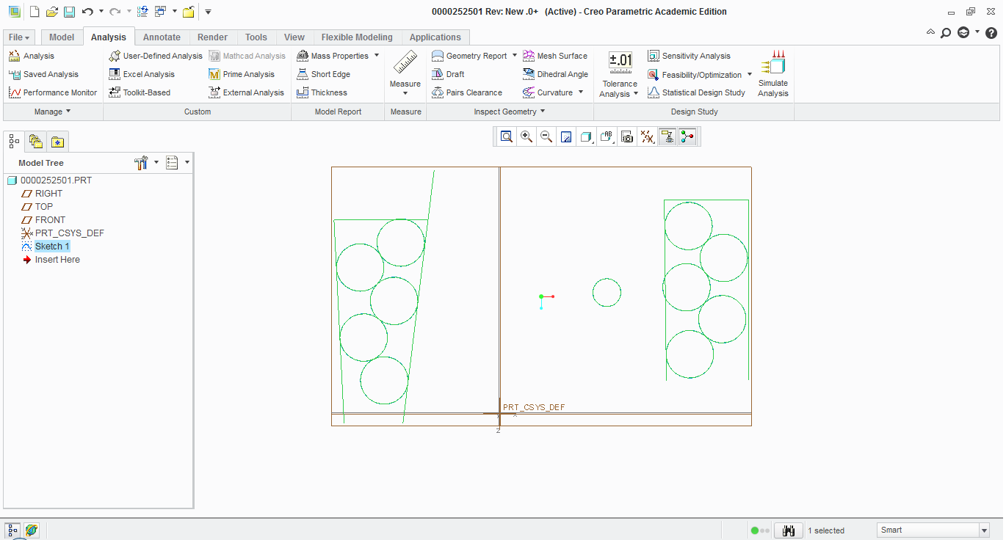
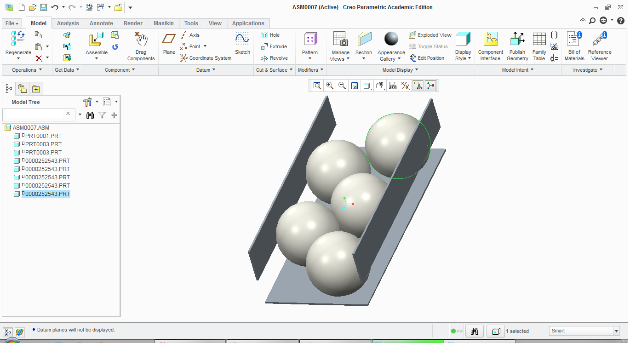
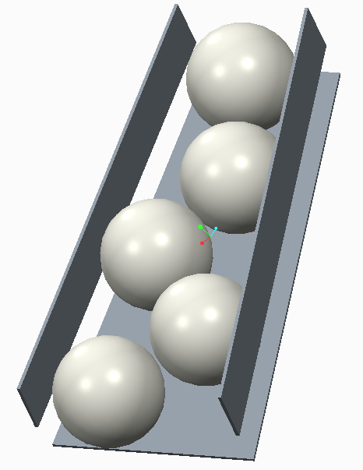
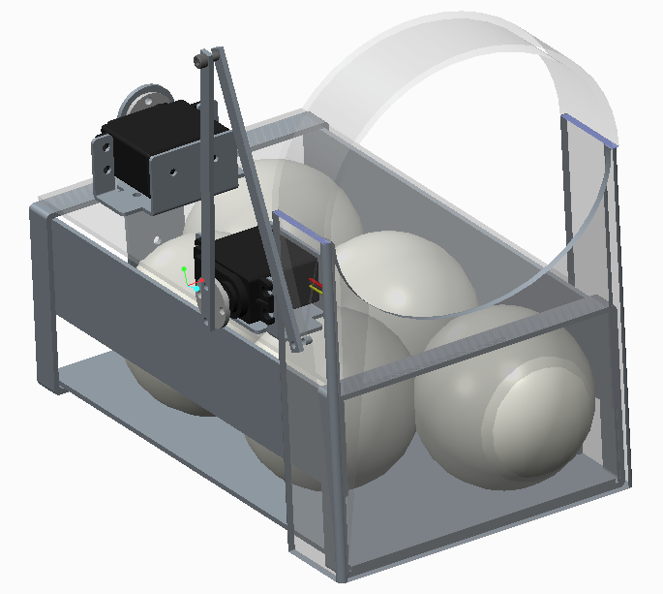
Ball Pick-Up Drafting
Notes:
Gloria

Slide 17
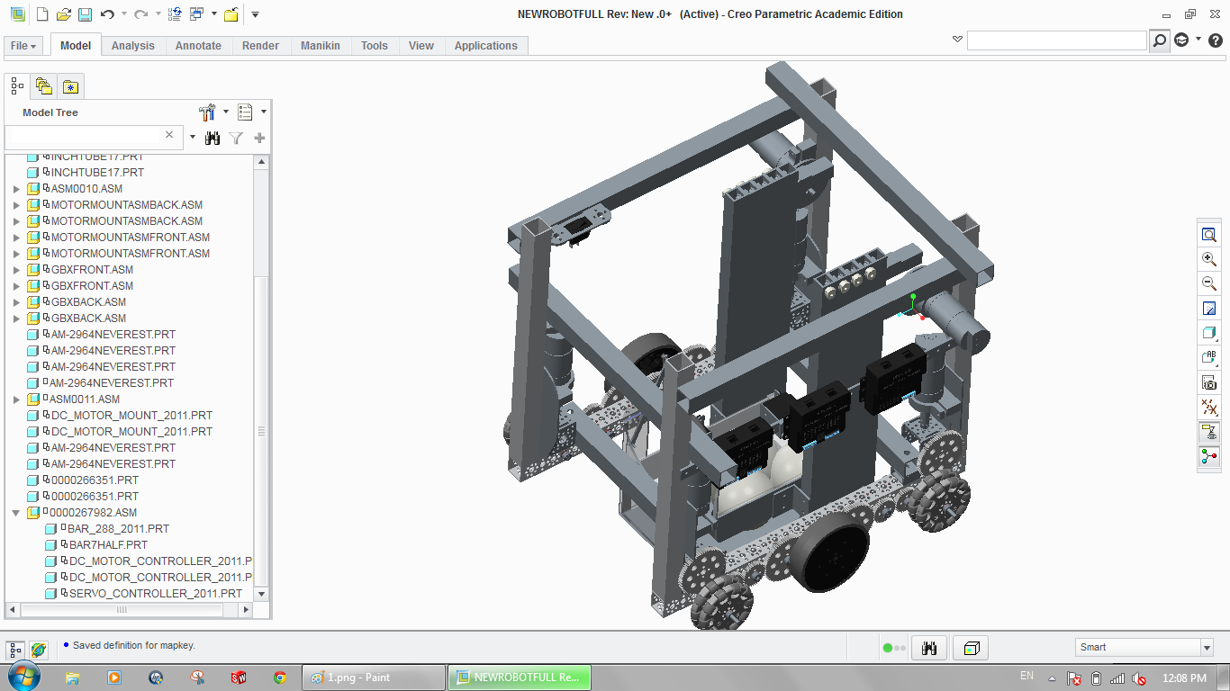
Competition Robot CAD

Slide 18
Awards
PTC Design Award
  “Recognizes design elements of the robot that are functional and aesthetic. All successful robots have innovative design aspects, however… incorporate industrial design elements into their solution.” -USFirst.org
  * Specifically, PTC is not required.
  Inspire Award
    “Truly embodied the ‘challenge’ of the FTC program… a strong ambassador for FIRST programs and a role model FTC team… a top contender for many other judged awards and is a gracious competitor… acting with Gracious Professionalism.”
    -USFirst.org
Notes:
Gloria

Slide 19
Questions and
Contact Info
Colleen was also here >:D
PTC Tetrix pieces:
  http://www.catalogds.com/db/service?domain=first&command=browse
PowerStackers Contacts:
  Website: www.powerstackersftc.com
  Email: powerstackers@gmail.com
  Facebook: PowerStackers 5029 First Tech Challenge Robotics Team
  Twitter: @PowerStackers
  Instagram: powerstackers5029
  Extra Note: Manuals
  Extra Note: This will be on website
Notes:
Caroline

